Slide 1
Computer Programming Adv
11
TEKNIK
File Storage
Teknik Elektro

Slide 2
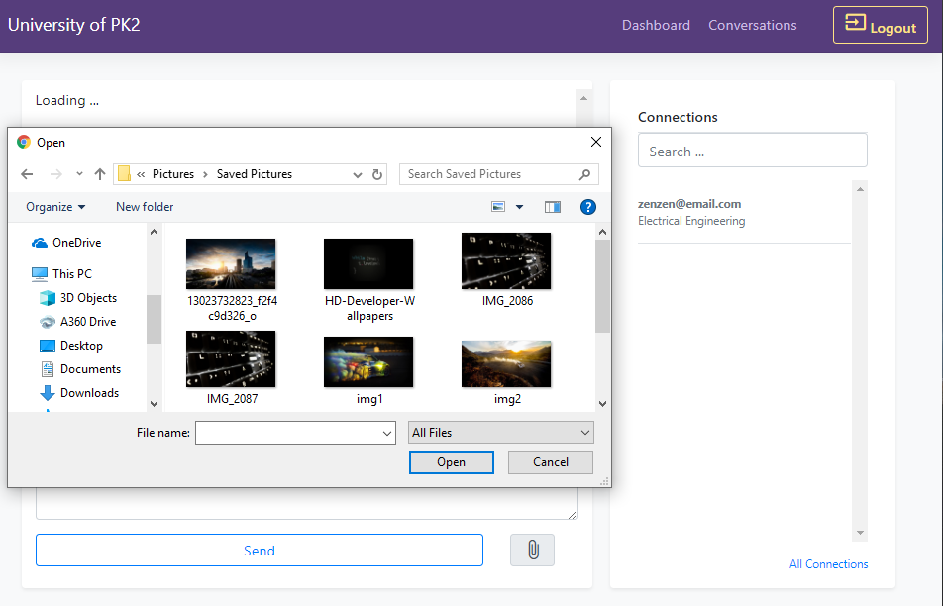
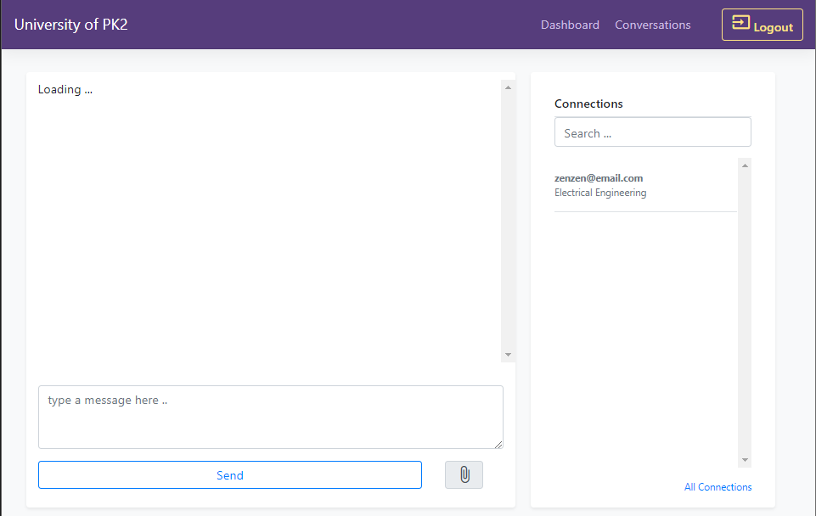

Slide 3
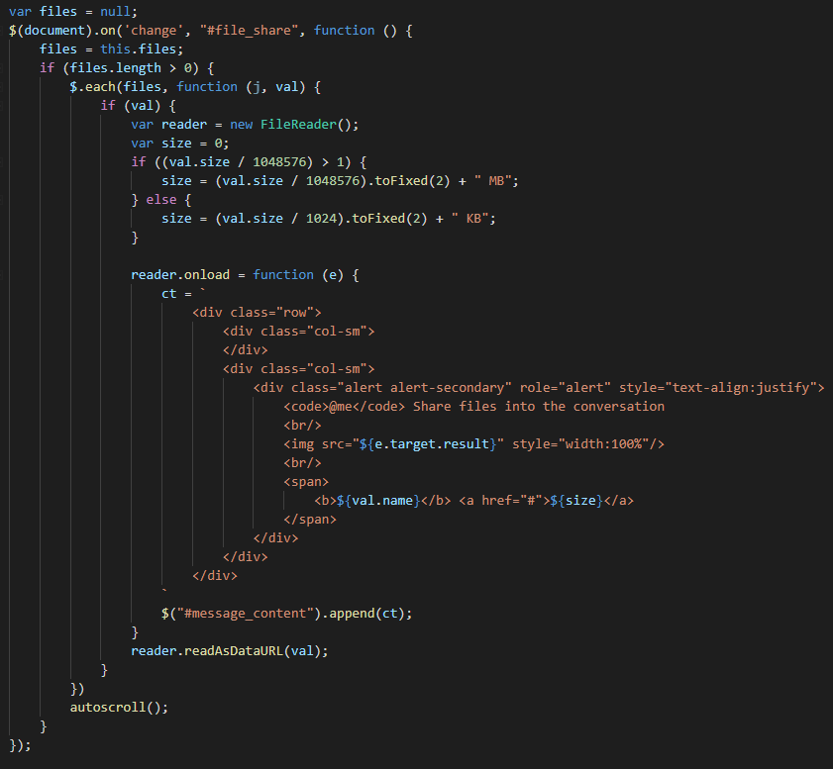
/public/javascripts/main/conversation.js

Slide 4
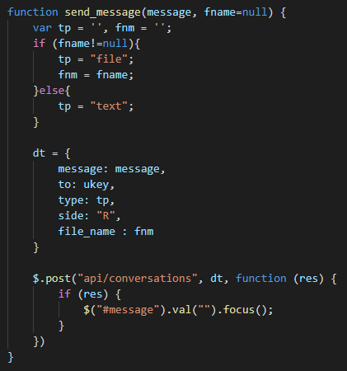
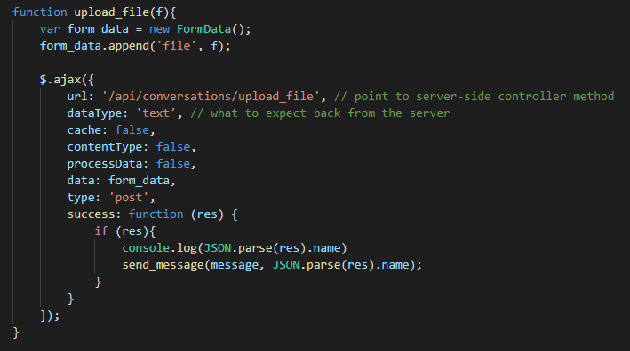
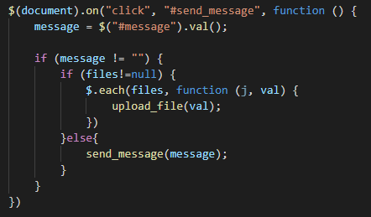
/public/javascripts/main/conversation.js

Slide 5
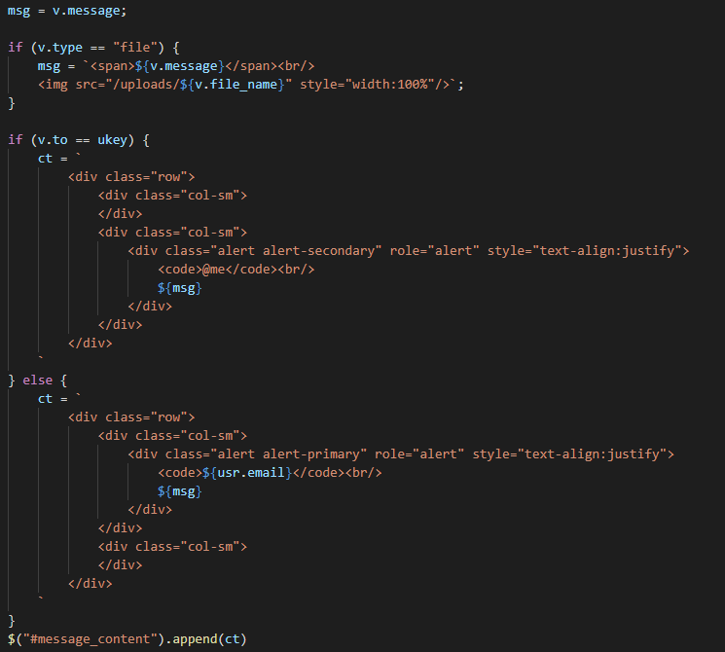
/public/javascripts/main/conversation.js
Modify both functions of get_conversations() and socket_service()

Slide 6
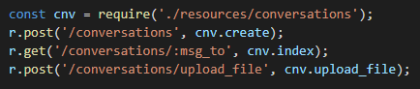
/api/index.js

Slide 7
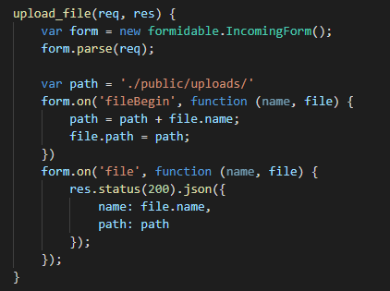
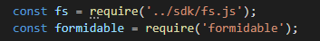
/api/resources/conversation.js

Slide 8
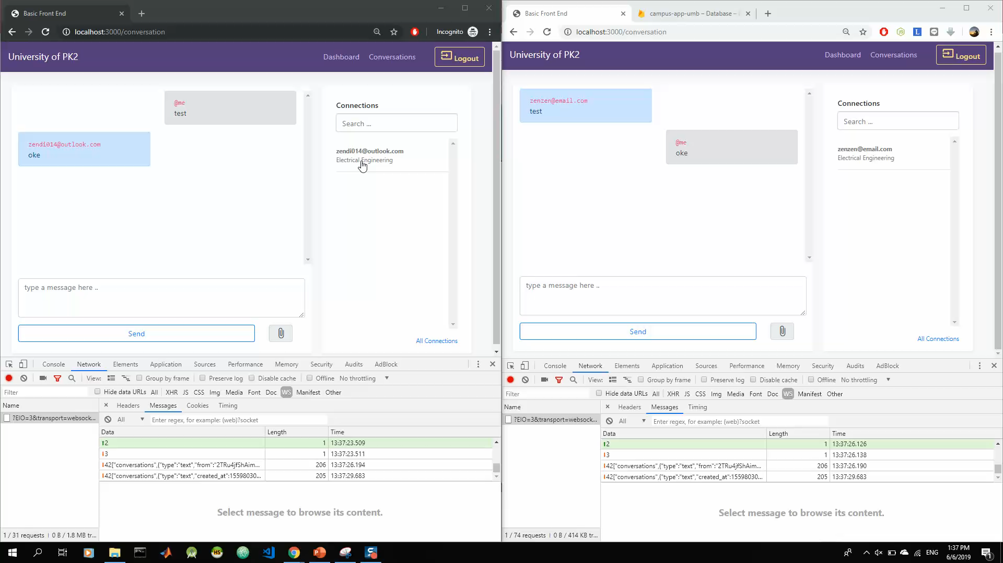

Slide 9
Zendi Iklima ST, SKom, MSc

